Slide 1
Avoiding Overfitting
Artificially expand your dataset
Laurence Moroney, Google

Slide 2
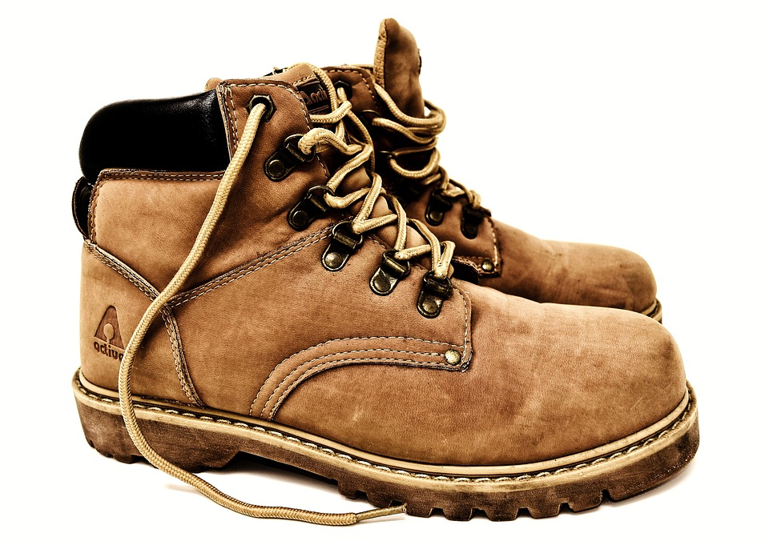
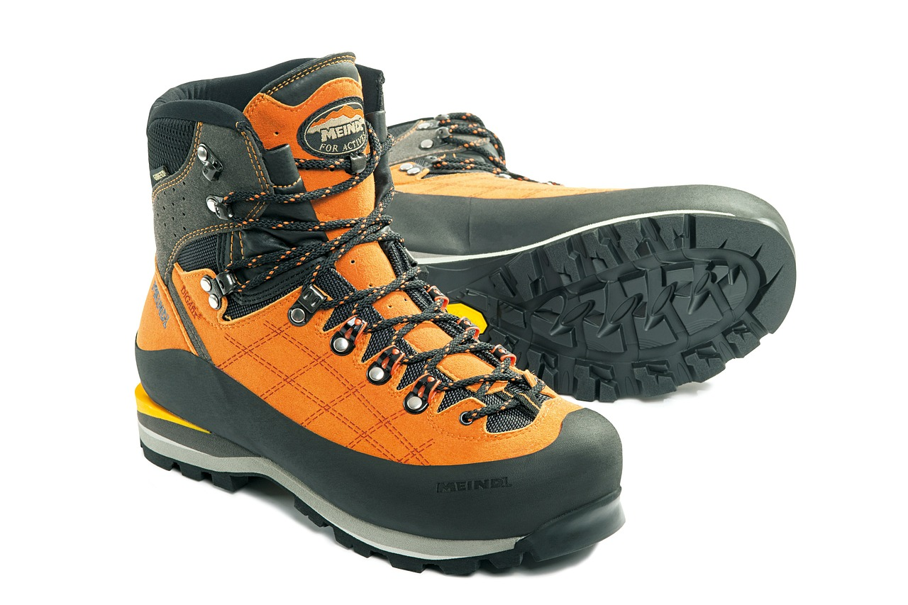
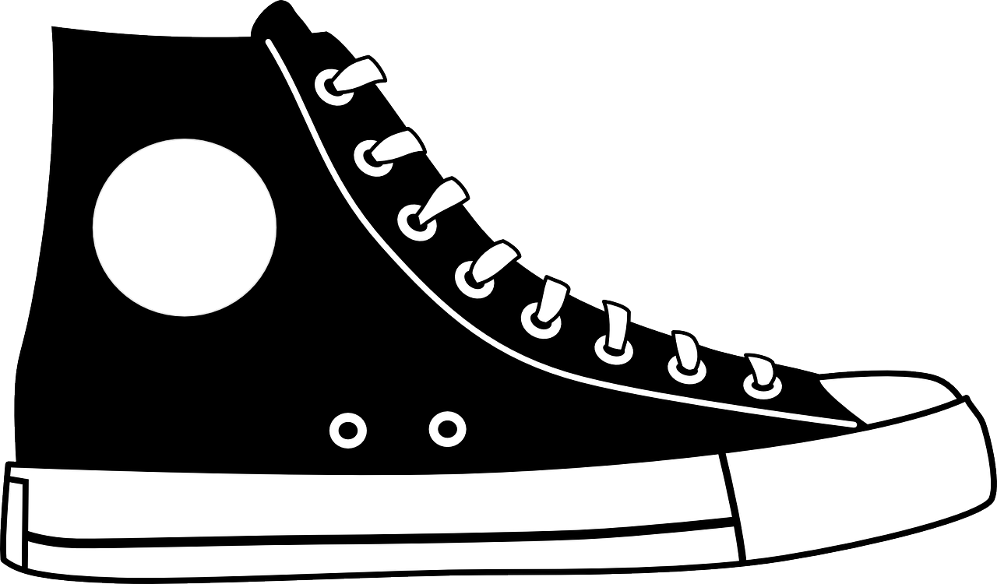
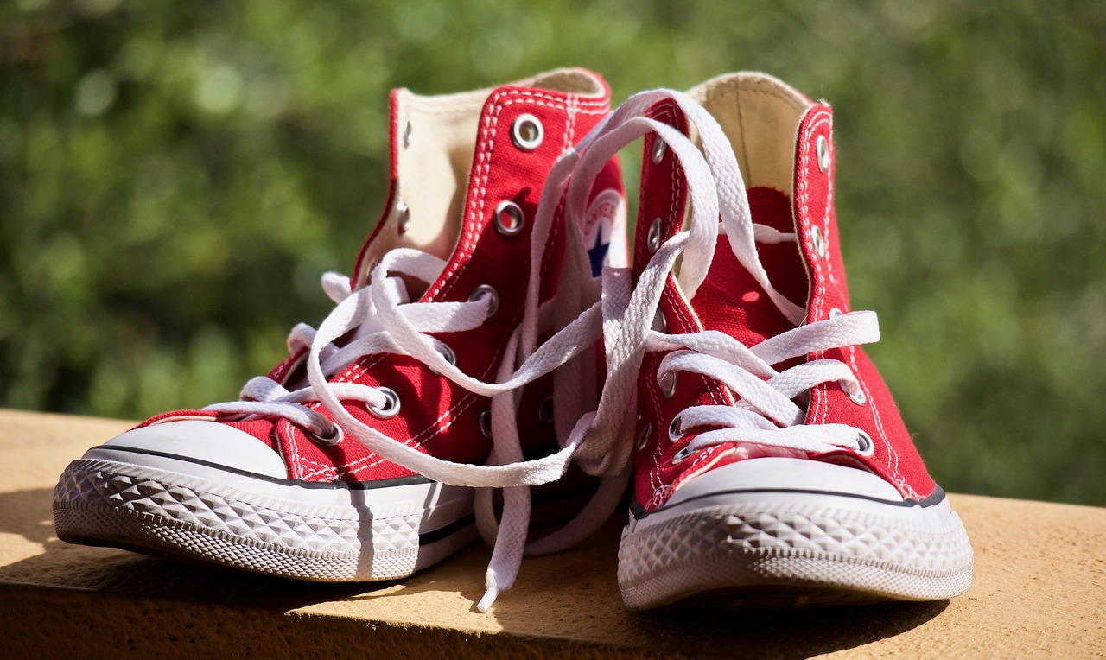
Notes:
All images are from Pixabay, public domain CC0

Slide 3
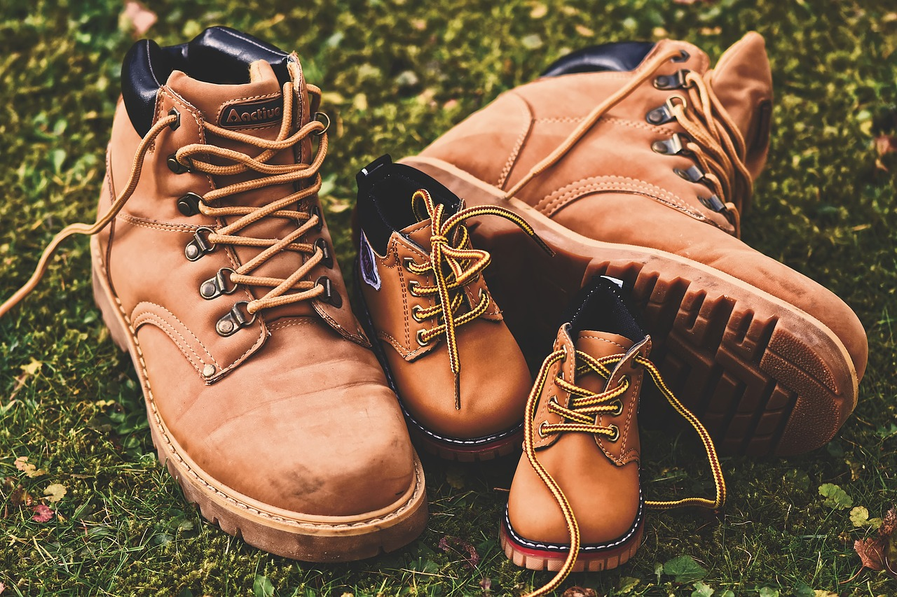
Notes:
Image is public domain CC0 from Pixabay

Slide 4
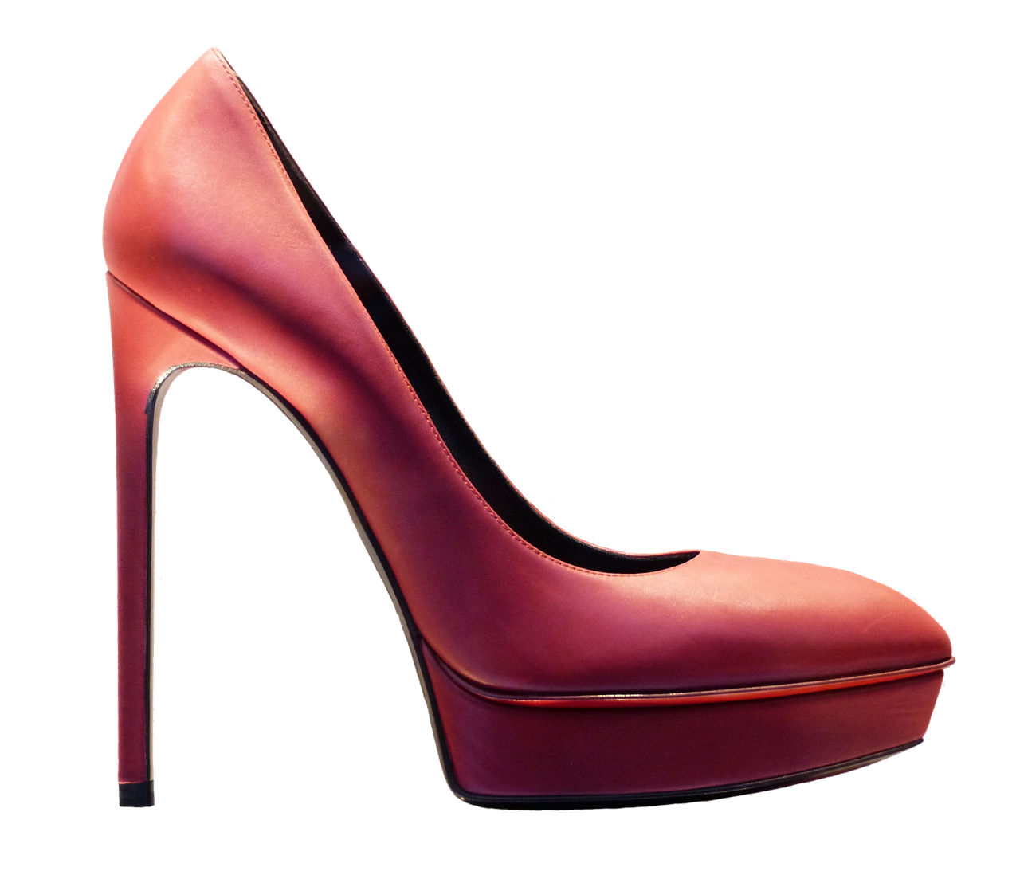
Notes:
Image is public domain CC0 from Pixabay

Slide 5
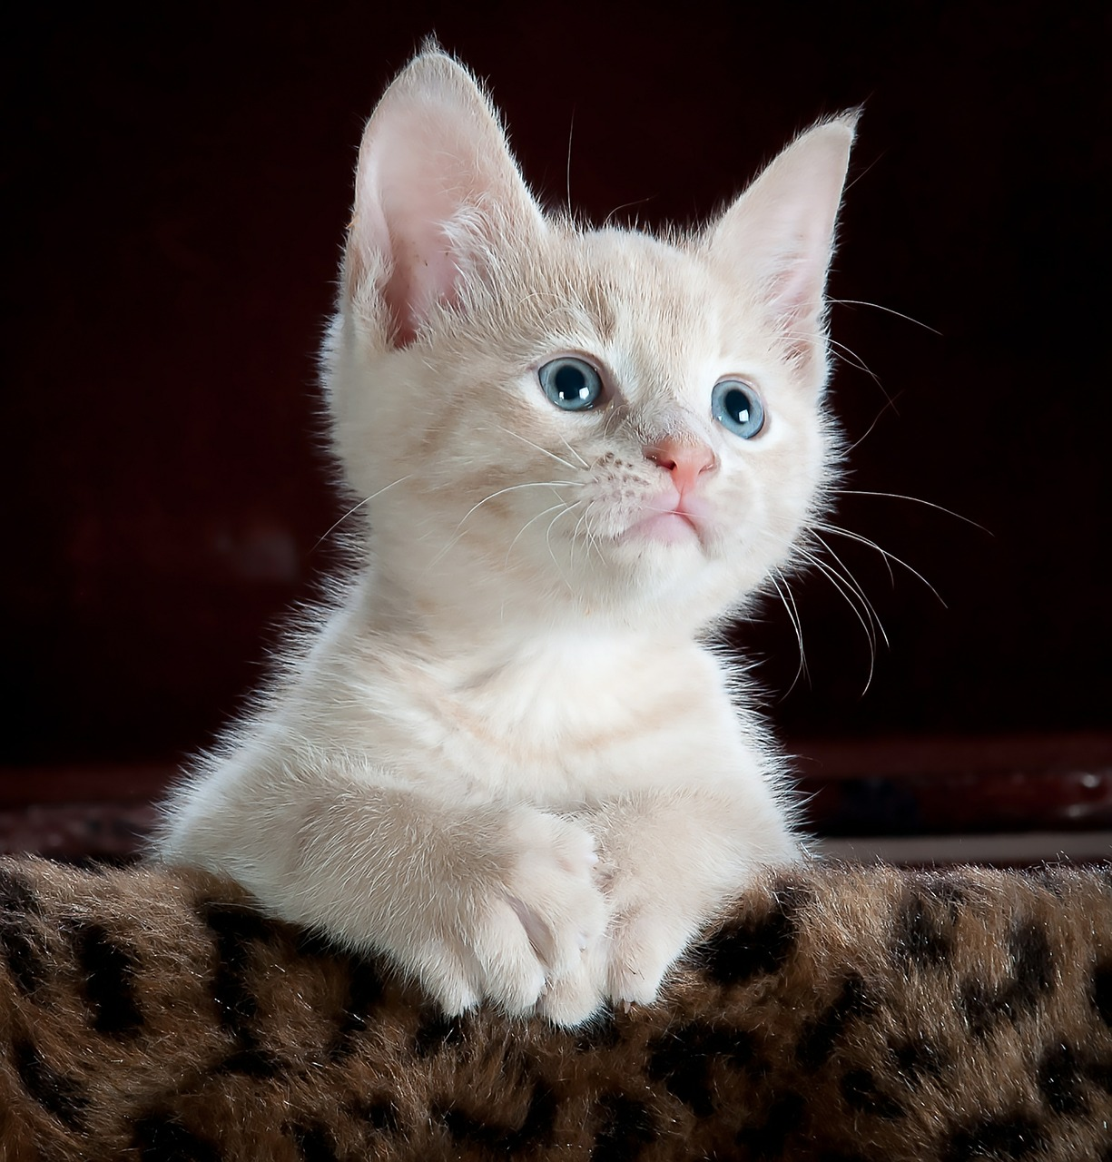
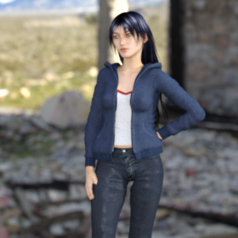
Notes:
Cat Image is public domain CC0 from Pixabay
Girl image from Horses or Humans dataset by lmoroney -- permission granted to use it

Slide 6
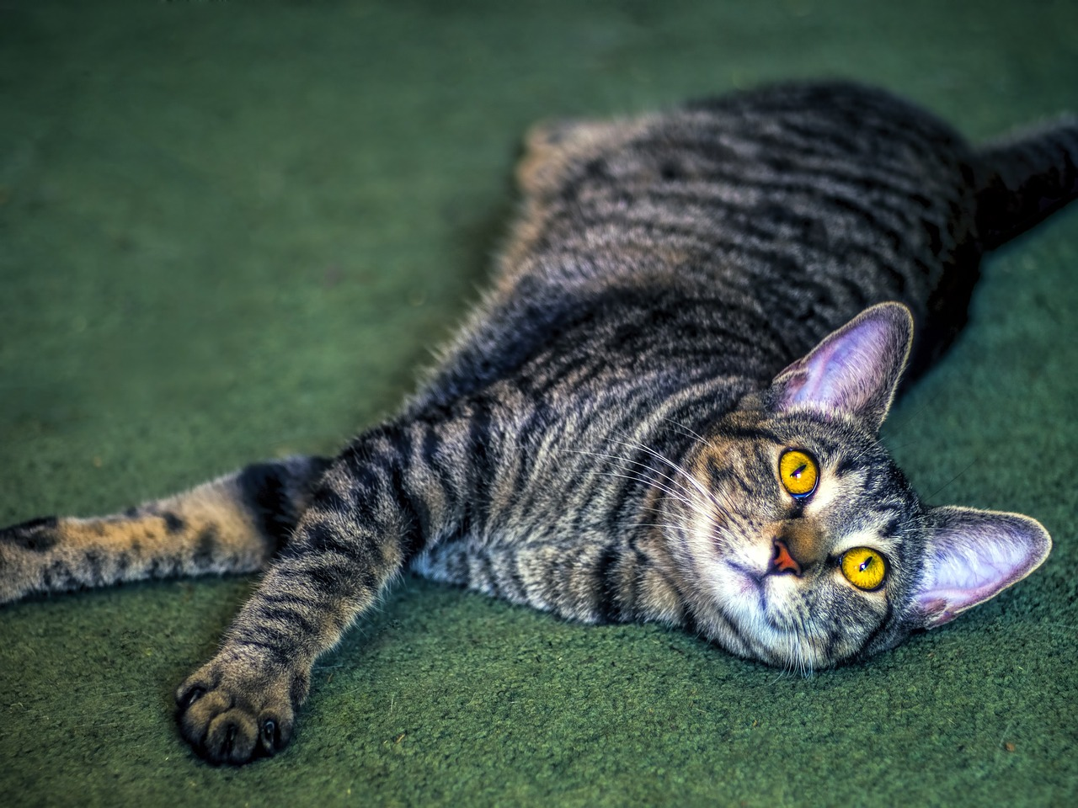

Slide 8
train_datagen = ImageDataGenerator(rescale=1./255)

Slide 9
train_datagen = ImageDataGenerator(rescale=1./255)

Slide 10
# Updated to do image augmentation
train_datagen = ImageDataGenerator(
rescale=1./255,
rotation_range=40,
width_shift_range=0.2,
height_shift_range=0.2,
shear_range=0.2,
zoom_range=0.2,
horizontal_flip=True,
fill_mode='nearest')

Slide 11
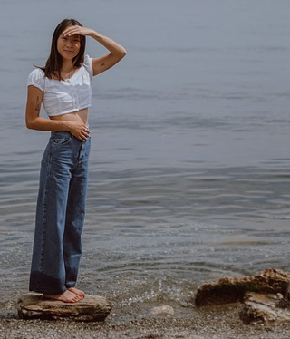
Notes:
https://pixabay.com/photos/female-model-pose-casual-sky-5440736/

Slide 12
Notes:
https://pixabay.com/photos/female-model-pose-casual-sky-5440736/

Slide 13
# Updated to do image augmentation
train_datagen = ImageDataGenerator(
rescale=1./255,
rotation_range=40,
width_shift_range=0.2,
height_shift_range=0.2,
shear_range=0.2,
zoom_range=0.2,
horizontal_flip=True,
fill_mode='nearest')

Slide 14
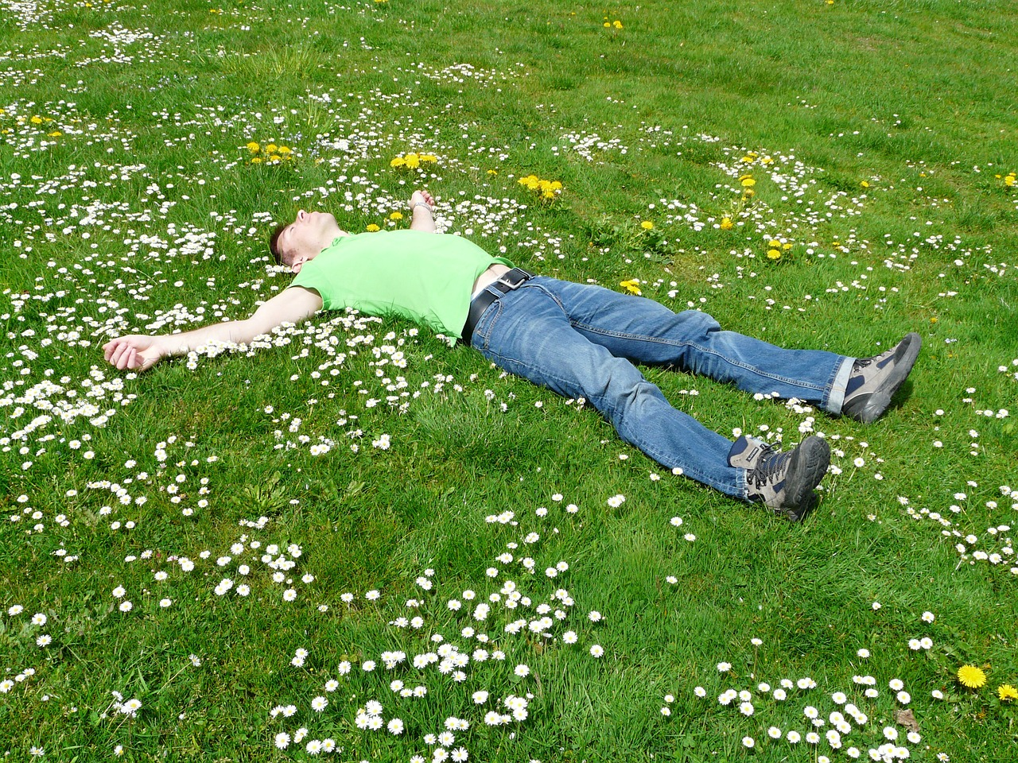
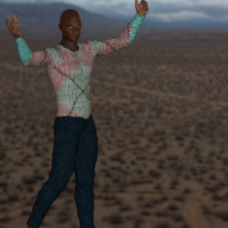
Notes:
Left Image from Horses or Humans
Right image is from Pixabay Public Domain CC0

Slide 15
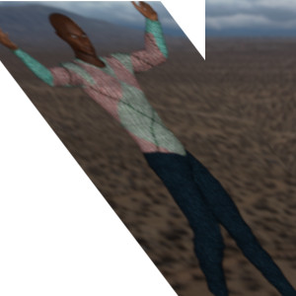

Slide 16
# Updated to do image augmentation
train_datagen = ImageDataGenerator(
rescale=1./255,
rotation_range=40,
width_shift_range=0.2,
height_shift_range=0.2,
shear_range=0.2,
zoom_range=0.2,
horizontal_flip=True,
fill_mode='nearest')

Slide 17

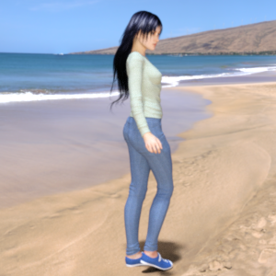
Notes:
Left Image from Horses or Humans
Right image is from Pixabay Public Domain CC0

Slide 19
# Updated to do image augmentation
train_datagen = ImageDataGenerator(
rescale=1./255,
rotation_range=40,
width_shift_range=0.2,
height_shift_range=0.2,
shear_range=0.2,
zoom_range=0.2,
horizontal_flip=True,
fill_mode='nearest')

Slide 20
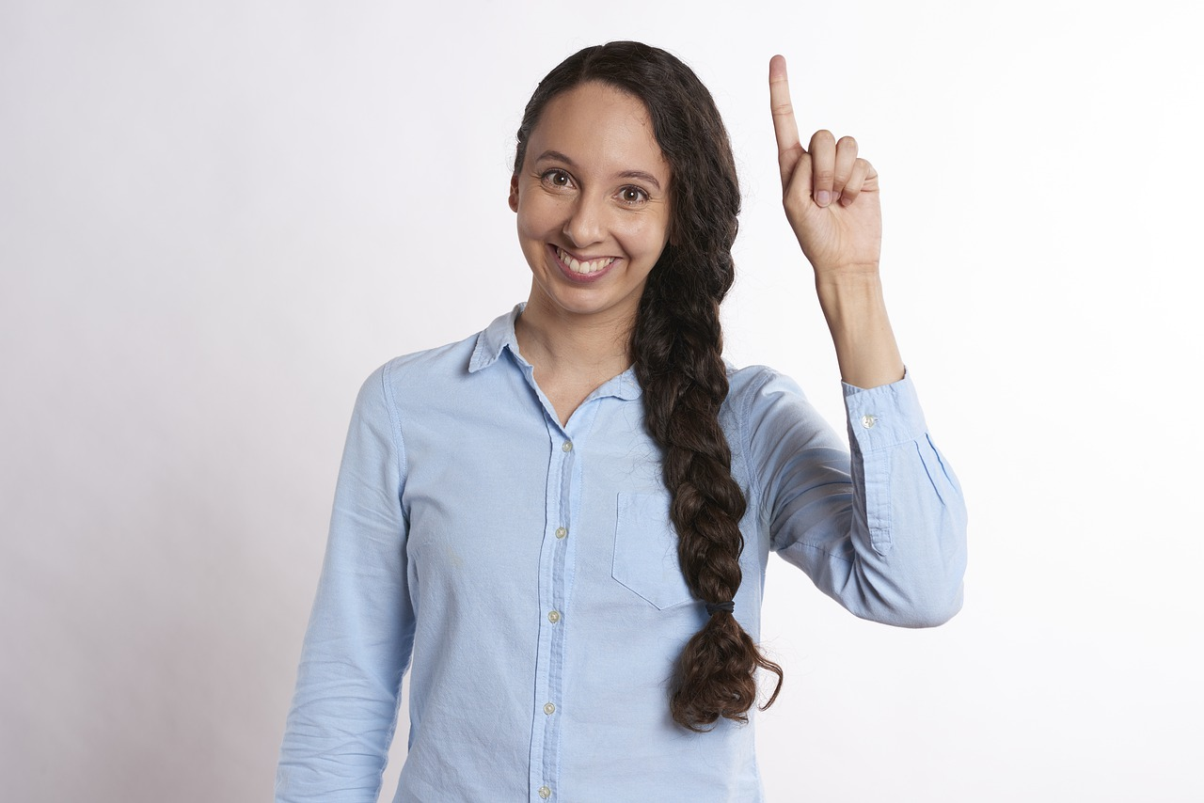
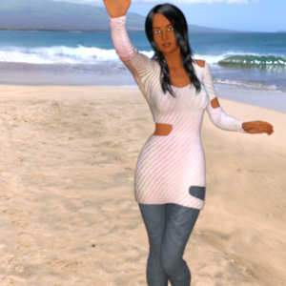
Notes:
Left Image from Horses or Humans
Right image is from Pixabay Public Domain CC0

Slide 22
# Updated to do image augmentation
train_datagen = ImageDataGenerator(
rescale=1./255,
rotation_range=40,
width_shift_range=0.2,
height_shift_range=0.2,
shear_range=0.2,
zoom_range=0.2,
horizontal_flip=True,
fill_mode='nearest')

Slide 23
# Updated to do image augmentation
train_datagen = ImageDataGenerator(
rescale=1./255,
rotation_range=40,
width_shift_range=0.2,
height_shift_range=0.2,
shear_range=0.2,
zoom_range=0.2,
horizontal_flip=True,
fill_mode='nearest')

Slide 24
Your turn!

